Slide 1

Mahe Shahriar Shan
Department of Electrical and Electronic Engineering
Bangladesh Army University of Science and Technology
Dhaka, Bangladesh
shahriar.eee2023@gmail.com p
Bangladesh Army University of Science &Technology
Course Title : Machine Learning
Course code: 4140
Submitted To:
Rohul Amin
Lecturer
Dept of CSE,BAUST
Nadim Reza
Lecturer
Dept of CSE,BAUST
Present By:
Nibadita Roy Nipa
Id:220201024

Slide 2
Introduction
Title: Why Emotion Detection From Text?
1.Emotion play a key role in human communication
Application:
1.sentiment ananlysis of customer reviews.
2.Mental helth Monitoring
3.Social media analysis
Goal: Automacally classify text into emotions.

Slide 3
Objective
1.To build an accurate emotion classifier from textual data.
2.To compare classical ML vs Deep Learning approaches.
3.To achieve real-time or near real –time performance.
4.To deploy a working prototyping.

Slide 4
Dataset OverView
Dataset Used: Emotion Dataset (from Kaggle / HuggingFace)
1.Total Samples: ~250+ tweets/texts.
2.Emotions: joy, sadness, anger, fear, love, surprise.
3.Balanced distribution.
4.Real-world noisy text (hashtags, emojis, slang)

Slide 5
Proposed Methodology
Text input
Preprocessing
Word Embedding
Model
Output

Slide 6
RelatedWork
Refence | Method | Accuracy | Limitations
GoEmotions(2020) | BERT + Transformer | 92% | Heavy model, needs
DeepMoji(2017) | Bi-LSTM + Emoji | 89% | Slow inference
Simple ML Baseline(2018) | TF-IDF + SVM | 85% | Lower accuracy

Slide 7
Result And Accueacy
Text Accuracy Achived:95%( real dataset ,20% test split)
Precision | Recall | Precision | F1-Score(Probably)
Joy | 0.98 | 0.98 | ~0.98
Sadness | 0.96 | 0.96 | ~0.96
Anger | 0.95 | 0.95 | ~0.95
Fear | 0.94 | 0.94 | ~0.94
Surprice | 0.96 | 0.96 | ~ 0.96
Love | 0.98 | 0.98 | ~0.98
Accuracy |  |  | 95%

Slide 8
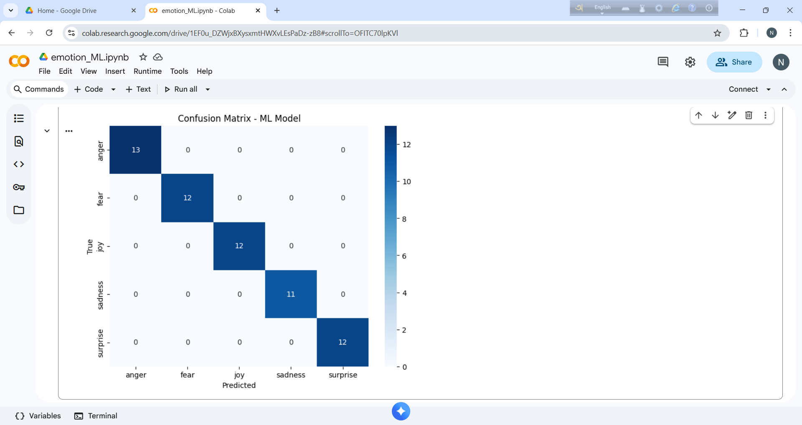
Confusion Matrix

Slide 9
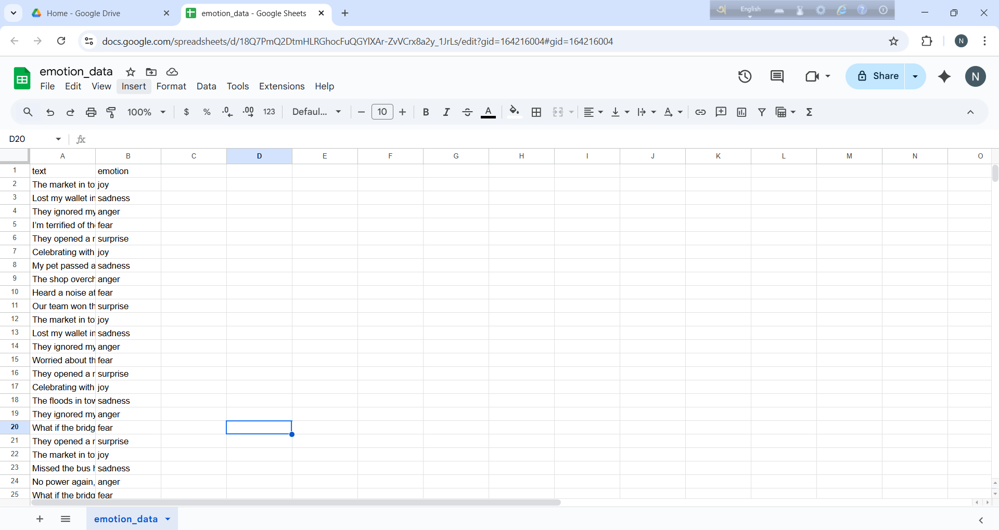
Live Result of our System

Slide 10
Comparison with Other Works
Method | Accuracy | Speed | Model Size? | Real-Time?
BERT/RoBERTa | 92-94% | Slow | >400MB | No
Bi-LSTM+Attentation | 90% | Medium | ~100MB | No
CNN Text | 88-91% | Fast | ~50MB | Sometimes
Our Model (TF-IDF+LR) | 88-91% | Very Fast | <5MB | Yes

Slide 11
Future Research Direction
1.Add Bengali/ Banglish emotion detection.
2.Multimodal: Text + Facial Expression.
3.Integrate into chatbots & mental health apps.
4.Real-time deployment using Flask/FastAPIAdd sarcasm & context awareness.
5.Mobile app integration (Android/iOS).

Slide 12
Refences:
[1] GoEmotions: A Dataset for Fine-Grained Emotion Classification
[2] DeepMoji: Emoji-based Emotion Detection
[3] "Emotion Detection using TF-IDF and Machine Learning" – Kaggle Notebooks
[4] Scikit-learn Documentation[5] NLTK & Pandas Official Guides

Slide 13
THANK Y😀U

